Slide 1
CXT 401 USER INTERFACE SOFTWARE & TECHNOLOGY

Slide 2
Module - 1 (Understanding User Behavior and Research)
Introduction to user research and its importance in interface design, Exploring user motivations and
behavior patterns -Analyzing common user behaviors - safe exploration, instant gratification,
satisficing, habituation, and streamlined repetition. Introduction to Bootstrap 5-layout structures- grid
system, containers, and spacing utilities.

Slide 3
Introduction
UIST stands for User Interface Software and Technology. It focuses on designing and improving the ways users interact with computers, smartphones, and other devices. This involves making software and hardware easy and enjoyable to use.
Good interface design doesn’t start with pictures.
It starts with an understanding of people: what they’re like, why they use a given piece of software, and how they might interact with it.
The more you know about them, and the more you empathize with them, the more effectively you can design for them.

Slide 4
Introduction
Each time someone uses an application, or any digital product, he carries on a conversation with the machine.
It may be literal, as with a command line or phone menu, or tacit, like the “conversation” an artist has with her paints and canvas the give and take between the craftsperson and the thing being built.
With social software, it may even be a conversation by proxy. Whatever the case, the user interface mediates that conversation, helping users achieve whatever ends they had in mind

Slide 5
As a user interface designer, you need to script the conversation, or at least define its terms.
And if you’re going to script a conversation, you should understand the human’s side as well as possible.
What are the user’s motives and intentions?
What “vocabulary” of words, icons, and gestures does the user expect to employ?
How can the application set expectations appropriately for the user?
How do the user and the machine finally end up communicating meaning to each other?
There’s a maxim in the field of interface design: “Know thy users, for they are not you!”

Slide 6
A Means to an End
Everyone who uses a tool , software or otherwise has a reason for using it. For instance:
Finding some fact or object
Learning something
Performing a transaction
Controlling or monitoring something
Creating something
Conversing with other people
Being entertained

Slide 7
A Means to an End
The first step in designing an interface is to figure out what its users are really trying to accomplish.
Filling out a form, for example, is almost never a goal in and of itself people only do it because they’re trying to buy something online, renew their driver’s license, or install software.

Slide 8
A Means to an End
Asking the right questions can help you connect user goals to the design process.
Users and clients typically speak to you in terms of desired features and solutions, not of needs and problems.
When a user or client tells you he wants a certain feature, ask why he wants it determine his immediate goal.
Then to the answer of this question, ask “why” again and again. Keep asking until you move well beyond the boundaries of the immediate design problem.

Slide 9
A Means to an End
Maybe you’re good at building forms that ask for just the right information, with the right controls, all laid out nicely.
But the real art of interface design lies in solving the right problem.

Slide 10
The Basics of User Research
User research aims to understand users' needs, behaviors, and challenges to design better interfaces and interactions.
To get a design started, you’ll need to characterize the kinds of people who will be using your design, and the best way to do that is to go out and meet them.
Each user group is unique.
The target audience for, say, a new mobile phone app will differ dramatically from the target audience for a piece of scientific software.
Even if the same person uses both, his expectations for each are different a researcher using scientific software might tolerate a less-polished interface in exchange for high functionality, whereas that same person may stop using the mobile app if he finds its UI to be too hard to use after a few days.

Slide 11
The Basics of User Research
Specifically, you’ll want to learn:
Their goals in using the software or site
The specific tasks they undertake in pursuit of those goals
The language and words they use to describe what they’re doing
Their skill at using software similar to what you’re designing
Their attitudes toward the kind of thing you’re designing, and how different designs might affect those attitude

Slide 12
The Basics of User Research
Unfortunately, this user-discovery phase will consume serious time early in the design cycle. It’s expensive. But it’s worth it, because you stand a better chance at solving the right problem—you’ll build the right thing in the first place

Slide 13
The Basics of User Research-METHODS
Direct observation
Interviews and onsite user visits put you directly into the user’s world. You can ask users about what their goals are and what tasks they typically do.
Interviews can be structured with a predefined set of questions or unstructured, where you probe whatever subject comes up. Interviews gives a lot of flexibility;

Slide 14
The Basics of User Research-METHODS
Case studies
They provide deep and detailed views of representative users or user groups.
Useful for exploring extreme users who push software boundaries, especially in redesign projects.
Essential for designing custom software for a specific user or site, understanding their context of use is crucial.
Surveys
Written surveys can collect information from many users.
Careful survey design is essential. If you want reliable numbers instead of a qualitative “feel” for the target audience, you absolutely must write the questions correctly, pick the survey recipients correctly, and analyze the answers correctly—and that’s a science.

Slide 15
The Basics of User Research-METHODS
Personas
Personas aren’t a data-gathering method, but they help to figure out what to do with the given data.
This is a design technique that “models” the target audiences.
For each major user group, it create a character that captures the most important aspects of the users in that group:
What tasks they’re trying to accomplish, their ultimate goals, and their experience levels in the subject domain and with computers in general.
Personas keep your design focused. As you work, ask yourself, "Would this persona really do X? What would they do instead?"

Slide 16
The Basics of User Research-METHODS
By above methods , designers are trying to understand the people who use the software
Some of these techniques are very formal, and some aren’t.
Formal and quantitative methods are valuable because they’re good science.
When applied correctly, they helps to see the world as it actually is, not how you think it is.
Even if there's no time for formal methods, it's better to meet a few users informally than to not do any discovery at all.

Slide 17
Users’ Motivation to Learn
When you carry on a conversation with someone about a given subject, you adjust what you say according to your understanding of the other person. You might consider
How much he cares about the subject,
How much he already knows about it,
How receptive he is
whether he’s even interested in the conversation in the first place
If you get any of that wrong, bad things happen he might feel uninterested, impatient, or utterly baffled.

Slide 18
Users’ Motivation to Learn
If they don’t know computers very well, don’t make them use sophisticated widget or uncommon interface-design conventions.
If their level of interest might be low, respect that, and don’t ask for too much effort for too little reward.
How much effort are your users willing to spend to learn your interface?
When designing software, consider how users will engage with it:
Some might use it daily and become experts.
Others might use it occasionally, learning enough to manage.
Many might only encounter it briefly, perhaps just once.
Be realistic: Will most users become intermediate or expert users, or will they likely stay beginners?

Slide 19
Users’ Motivation to Learn
Software designed for intermediate-to-expert users includes:
Photoshop
Dreamweaver
Excel
Code development environments
System-administration tools for web servers

Slide 20
Users’ Motivation to Learn
In contrast, here are some things designed for occasional users:
• Kiosks in tourist centers or museums
• Windows or Mac OS controls for setting desktop backgrounds
• Purchase pages for online stores
• Installation wizards
• Automated teller machines

Slide 21
Users’ Motivation to Learn
The truth is that most applications fall into this middle ground.
They need to serve people on both ends adequately to help new users learn the tool (and satisfy their need for instant gratification), while enabling frequent-user intermediates to get things done smoothly.

Slide 22
The Patterns
Even though individuals are unique, people behave predictably.
Designers and researchers have spent years doing site visits and observing users to understand how they think and act.
When you watch people using your software or engaging in activities that the new software supports, you'll notice certain behavioral patterns.
These patterns are commonly observed in user studies.
User behavior refers to the way users interact with your app and its features.
User behavior patterns are common behaviors people exhibit when interacting with a product’s user interface (UI).

Slide 23
The Patterns
Creating an interface that fits these user patterns helps them achieve their goals more effectively.
It's not just about the interface—it includes everything like how the software works, the features it offers, and the instructions
As a designer, you need to think about these aspects as much as anyone else

Slide 24
Safe Exploration
Let user explore without getting into trouble. Support functions like “undo” and “go back”. Provide warnings about and before destructive actions.
Good software allows people to try something unfamiliar, back out, and try something else, all without stress.
Even minor inconveniences can stop people from trying things.
Things like closing pop-ups, redoing lost work, or muting unexpected loud music on a website can be frustrating.
When designing software, give users lots of ways to explore without hassle or cost.

Slide 25
Safe Exploration
Design Strategies:
Undo Options: Provide clear and simple ways to reverse actions.
Confirmation Prompts: Use prompts to confirm important or potentially harmful actions.
Non-destructive Actions: Ensure that exploring options does not result in data loss or major disruptions.
Designing with safe exploration in mind helps users feel confident while interacting with the interface and encourages them to fully explore its features.

Slide 26
Safe Exploration
This pattern encompasses several of the most effective usability guidelines, based on research, as identified by usability expert Jakob Nielsen:²
Visibility of system status
Match between the system and the real world
User control and freedom
Example
A photographer tries out a few image filters in an image-processing application. He then decides he doesn’t like the results, and clicks Undo a few times to get back to where he was. Then he tries another filter, and another, each time being able to back out of what he did

Slide 27
Instant Gratification
I want to accomplish something now, not later.
Instant gratification in UIST refers to the user’s desire for immediate rewards or feedback when interacting with a system or interface.
If someone starts using an application and gets a “success experience” within the first few seconds, that’s gratifying! He’ll be more likely to keep using it, even if it gets harder later.
They will feel more confident in the application, and more confident in themselves, than if it had taken a while to figure things out.
Importance:
User Satisfaction: Providing quick responses and results enhances the user experience and keeps users engaged.
Efficiency: Users prefer interfaces that offer immediate feedback, which helps them feel productive and reduces frustration.

Slide 28
Instant Gratification
Design Strategies:
Responsive Feedback: Ensure that the interface provides immediate visual or auditory feedback for user actions.
Fast Loading Times: Optimize performance to minimize delays in processing and displaying results.
Streamlined Processes: Simplify tasks to reduce waiting times and provide instant outcomes. Avoid placing introductory functions behind barriers like registrations, long instructions, slow-loading screens, or advertisements.
Designing for instant gratification makes the experience more enjoyable and user-friendly by giving users quick and satisfying responses.

Slide 29
Satisficing
This is good enough. I don’t want to spend more time learning to do it better.”
Satisficing is a decision-making strategy where users select the first option that meets their needs sufficiently, rather than searching for the optimal or perfect choice.
User Behavior: Users often choose the first option that seems good enough rather than exploring all possibilities.
Don’t Make Me Think , people don’t like to think any more than they have to it’s work!

Slide 30
Satisficing
This means several things for designers(Design Implications:):
Give directions to user.
Make labels short and easy to read.
Use the layout of the interface to communicate meaning.
Make it easy to move around the interface, especially for going back to where a wrong choice might have been made.
Keep cognitive load low.
Make it hard to (learn to) do things wrong.

Slide 31
Satisficing
The term satisficing is a combination of satisfying and sufficing, which is used it to describe the behavior of people in all kinds of economic and social situations.

Slide 32
Habituation
“That gesture works everywhere else; why doesn’t it work here, too?”
Habituation refers to the process where users become familiar with certain actions or gestures in a user interface through repeated use.
Benefits:
Expertise: Users become more skilled and efficient with the tool.
Flow: Helps users work smoothly without needing to think about every action.

Slide 33
Habituation
Risks:
Unexpected Problems: Users might rely on habitual gestures that don’t work in all situations.
Confusion: If a habit doesn’t work or causes issues, users may be confused and need to figure out how to fix it or correct mistakes.
Understanding habituation helps in designing interfaces that support efficient use while minimizing potential problems.

Slide 34
Streamlined Repetition
Streamlined repetition involves making repetitive tasks more efficient and less tedious by simplifying and automating them.
Importance:
Increases Efficiency: Reduces the time and effort required to perform repeated actions.
Enhances User Experience: Makes interactions smoother and less frustrating for users.

Slide 35
Streamlined Repetition
Design Strategies:
Automate Tasks: Implement features like shortcuts, macros, or automation tools to handle repetitive actions.
Consistent Design: Use consistent layouts and controls to make repeated tasks easier to perform.
Provide Feedback: Offer clear feedback for repeated actions to confirm that tasks are completed successfully.
Designing for streamlined repetition helps users perform repetitive tasks more quickly and with less effort, improving overall efficiency and satisfaction.

Slide 36
Streamlined Repetition
EXAMPLE
Find and Replace dialog boxes, commonly used in text editors (like Word or email composers), are designed to simplify repetitive tasks. Users enter the old phrase and the new phrase, then use a single Replace button to change each occurrence one by one. If users are sure they want to replace every instance, they can click the Replace All button, which performs the entire task with just one click.

Slide 37
BOOTSTRAP
What is Bootstrap?
Bootstrap is a free front-end framework for faster and easier web development
Bootstrap includes HTML and CSS based design templates for typography, forms, buttons, tables, navigation, modals, image carousels and many other, as well as optional JavaScript plugins
Bootstrap also gives you the ability to easily create responsive designs
What is Responsive Web Design? Responsive web design is about creating web sites which automatically adjust themselves to look good on all devices, from small phones to large desktops.

Slide 38
Bootstrap 5
Bootstrap 5 (released 2021) is the newest version of Bootstrap (released 2013); with new components, faster stylesheet and more responsiveness.
Bootstrap 5 supports the latest, stable releases of all major browsers and platforms. However, Internet Explorer 11 and down is not supported.
The main differences between Bootstrap 5 and Bootstrap 3 & 4, is that Bootstrap 5 has switched to vanilla JavaScript instead of jQuery.

Slide 39
Advantages of Bootstrap:
Easy to use: Anybody with just basic knowledge of HTML and CSS can start using Bootstrap
Responsive features: Bootstrap's responsive CSS adjusts to phones, tablets, and desktops
Mobile-first approach: In Bootstrap, mobile-first styles are part of the core framework
Browser compatibility: Bootstrap 5 is compatible with all modern browsers (Chrome, Firefox, Edge, Safari, and Opera). Note that if you need support for IE11 and down, you must use either BS4 or BS3.

Slide 40
Create Your First Web Page With Bootstrap 5
.
Bootstrap 5 uses HTML elements and CSS properties that require the HTML5 doctype.
Always include the HTML5 doctype at the beginning of the page, along with the lang attribute and the correct title and character set:
Bootstrap 5 is designed to be responsive to mobile devices. Mobile-first styles are part of the core framework.
To ensure proper rendering and touch zooming, add the responsive viewport meta tag <meta> tag inside the <head> element:

Slide 41
<!DOCTYPE html> <html lang="en"> <head> <title>Bootstrap Example</title> <meta charset="utf-8"> <meta name="viewport" content="width=device-width, initial-scale=1"> </head>
The width=device-width part sets the width of the page to follow the screen-width of the device (which will vary depending on the device).
The initial-scale=1 part sets the initial zoom level when the page is first loaded by the browser.

Slide 42
Breakpoints
Breakpoints are customizable widths that determine how your responsive layout behaves across device or viewport sizes in Bootstrap.

Slide 43
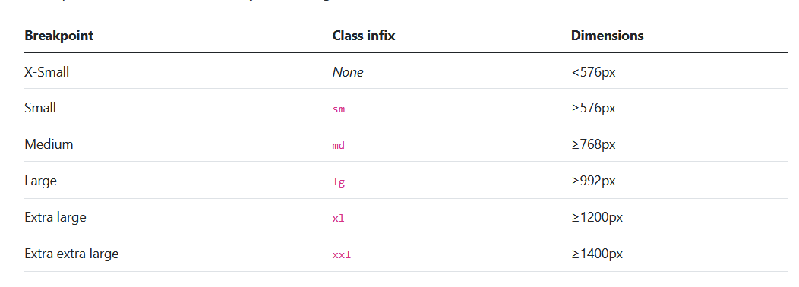
Breakpoints
Bootstrap includes six default breakpoints, sometimes referred to as grid tiers, for building responsively.

Slide 44
Containers
Containers are the most basic layout element in Bootstrap and are required when using our default grid system.
Containers are used to contain, pad, and (sometimes) center the content within them. While containers can be nested, most layouts do not require a nested container.

Slide 45
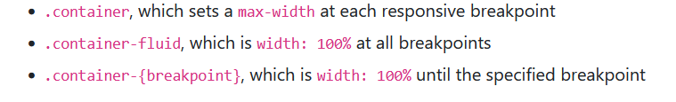
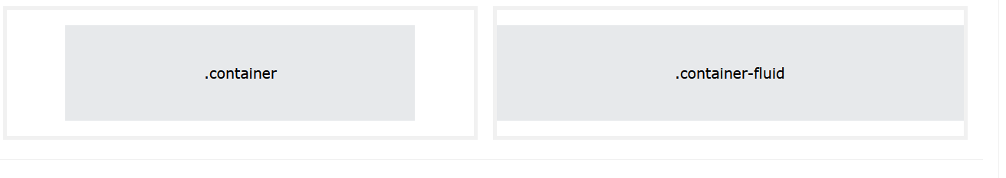
Bootstrap comes with three different containers:
container- Default container/Fixed Container
container-{breakpoint} – Responsive container
.

Slide 46
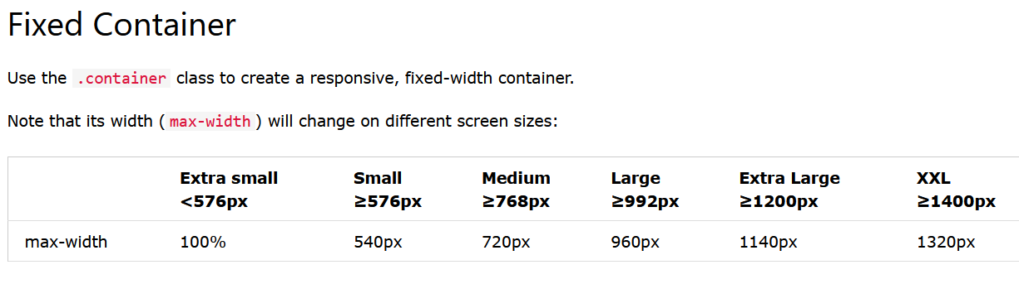
<div class="container"> <h1>My First Bootstrap Page</h1> <p>This is some text.</p> </div>

Slide 47
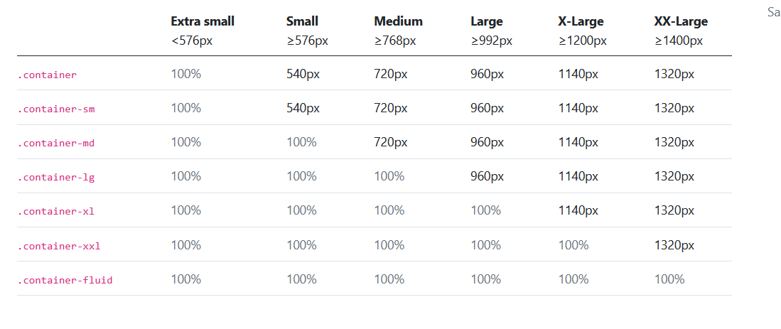
Responsive Container

Slide 48
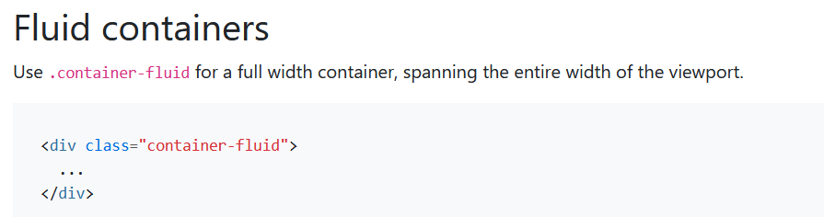

Slide 49
Container Border and Color
Other utilities, such as borders and colors, are also often used together with containers:
<div class="container p-5 my-5 bg-primary text-white"></div>

Slide 50
Bootstrap 5 Grid System
Mobile-first flexbox grid to build layouts of all shapes and sizes with a twelve column system, six default responsive tiers.
Bootstrap's grid system is built with flexbox and allows up to 12 columns across the page.
If you do not want to use all 12 columns individually, you can group the columns together to create wider columns:
The grid system is responsive, and the columns will re-arrange automatically depending on the screen size.

Slide 51
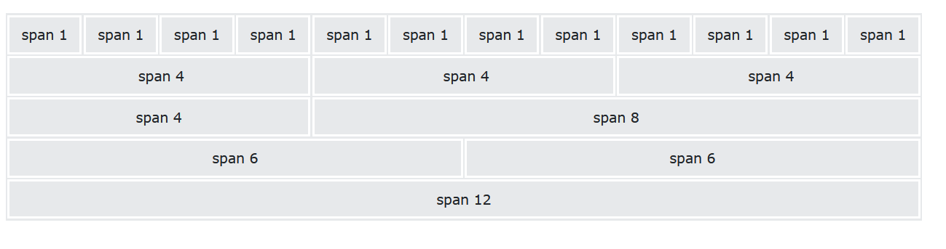
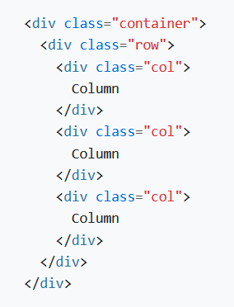

Slide 52
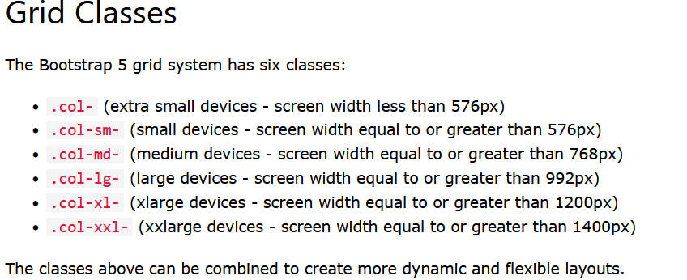

Slide 53
Our grid supports six responsive breakpoints.
Containers center and horizontally pad your content.
Rows are wrappers for columns.
Columns are incredibly flexible. There are 12 template columns available per row, allowing you to create different combinations of elements that span any number of columns.
Gutters are also responsive and customizable. Gutter classes are available across all breakpoints, with all the same sizes as our margin and padding spacing. (Gutters are the padding between your columns, used to responsively space and align content in the Bootstrap grid system.)

Slide 54
BOOTSTRAP- Utilities
BOOTSTRAP provides a lot of utilities to make a stylish, mobile-friendly, and responsive front-end website without using any CSS code. The utility layout is used for showing, hiding, aligning, and spacing content.
Bootstrap 5 utilities for layout:
Changing display: Bootstrap 5 provides some display properties for setting the display. Some display properties like set to display responsive and display toggling, etc. It can be mixed with a grid system, content, or component for a responsive output.
Flexbox options: The Flexible Box Layout Module in bootstrap5 is used for designing the flexible and responsive layout structure. Most of the components are made with flexbox enabled.
Margin and padding: In Bootstrap 5, we use the margin and padding (spacing) utility to set the space and size of an element. It includes a six-level scale for spacing utilities, based on a 1rem value. We can choose values for viewports or choose specific viewports.
Toggle visibility: Bootstrap 5 regulates element visibility without changing display content. Invisible elements still affect the page layout but are hidden from display.

Slide 55
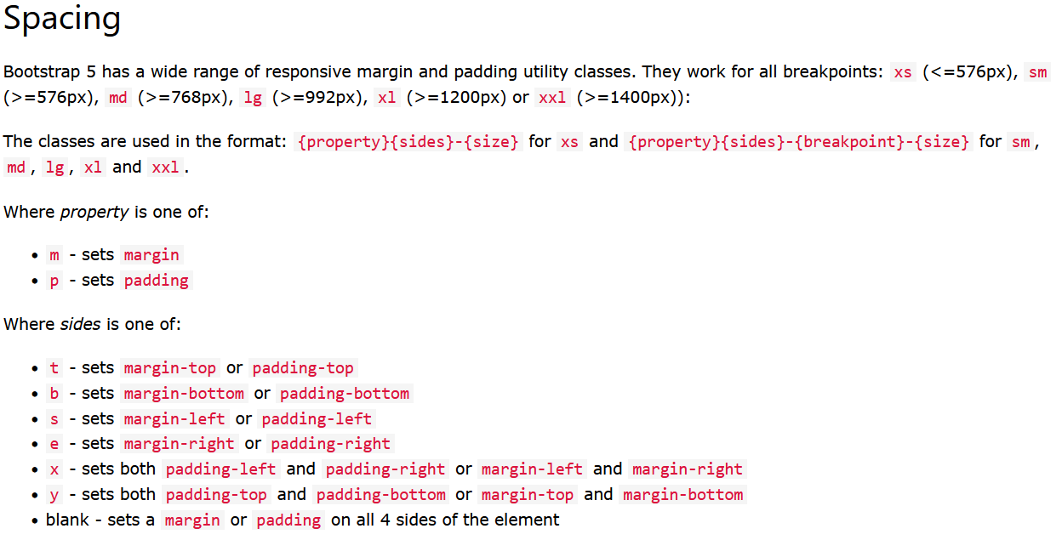
BOOTSTRAP- Utilities

Slide 56
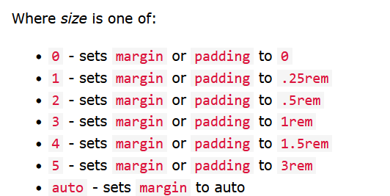

Slide 57
Horizontal centering
Additionally, Bootstrap also includes an .mx-auto class for horizontally centering fixed-width block level content—that is, content that has display: block and a width set—by setting the horizontal margins to auto.
<div class="mx-auto" style="width: 200px;">
Centered element
</div>
Negative margin
In CSS, margin properties can utilize negative values (padding cannot). These negative margins are disabled by default, but can be enabled in Sass by setting $enable-negative-margins: true.
The syntax is nearly the same as the default, positive margin utilities, but with the addition of n before the requested size. Here’s an example class that’s the opposite of .mt-1:
.mt-n1 {
margin-top: -0.25rem !important;
}

Slide 58
Importance in interface design
The user interface design is important because it influences how people interact with your product to achieve their goals and satisfy their needs.
What is a User Interface?
Simply put, the User Interface is the place for user-computer interaction and communication. For a website, it is the link between users and a website.
User interface refers to those qualities which make a website, application, or software easily accessible for users.
User Interface is not just the look and feel, but much more than that.

Slide 59
It’s a combination of attributes and features that your website or software provides.
A good User interface is a combination of design, good human-computer interaction, appealing graphics, organized layout, proper screen fit, and good typography among other characteristics.
In general, UI is further divided into three sub-categories:
1. Graphical control Interfaces such as the desktop operating systems and mobile operating systems that use GUI.
2. Voice-controlled interfaces smart assistants like Siri, Alexa, and google assistance interact with humans with artificial voice.
3. Gesture-based interfaces are the most recent type and include 3-D design spaces, VR games, etc.

Slide 60
What is the Importance of User Interface?
The user interface not only serves one but many purposes for a successful website application such as handling traffic, attracting visitors, linking seamlessly with users’ needs, helping visitors understand the overall website, and other technical features.
1. To build confidence and acquire new customers.
2. To increase customer conversion.
3. To reduce confusion and boost customer retention.

Slide 61
1. To build confidence and acquire new customers
A quality user interface builds a confident environment throughout your website that users find trustworthy.
Customers are automatically attracted to a website that is well designed, easy to navigate, delivers the right information.
The competition is always high, and competitors are trying hard to improve user interface and design to attract the same audience you are working hard to impress.
Having a good user experience keeps your website a step ahead of competitors and helps you stand out for your audience.

Slide 62
2. To increase customer conversion
User interface design is one of the main ways to increase traffic to your website.
A good UI design captivates your visitors and persuades them to stay longer on your site.
A good UI design is an intelligent interface that can assist visitors to buy your products and also provide a great user experience.
Since visitors are impressed by an impactful website, there’s a higher chance that they’ll turn into a customer and go on to recommend your website to others, which is free mouth-to-mouth advertising for your website.

Slide 63
3. To reduce confusion and boost customer retention
The purpose of UI is to make a website as user-friendly as possible.
If a website has a disproportionate setup, poor color contrast, unnecessary pop-ups, and haphazard grouping of tools it will be confusing for visitors to move ahead in the website.
UI designers ensure that a website is tidy, organized, appealing, and problem-solving.
This will attract more customers and result in better conversion rates. Customers who like your website will be loyal to your brand.
With a better SEO, your website will further improve in reaching a greater audience that will boost traffic and maximize customer retention.

Slide 64
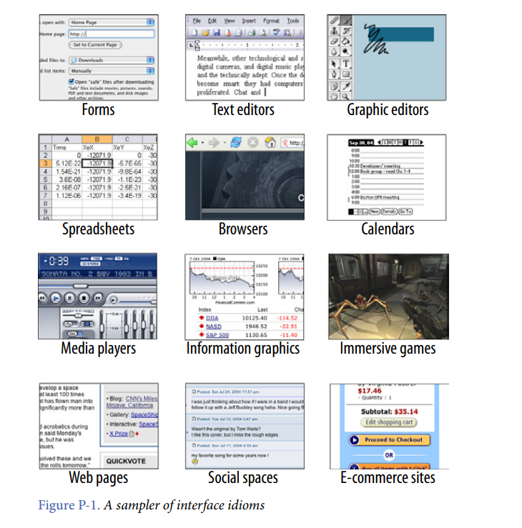
Small Interface Pieces, Loosely Joined

